Slide 1

Lauren Randall, Business Strategist
Chantal Raineri, Business Strategist
Tony Mahon, Executive Vice President
January 27, 2021

Slide 2


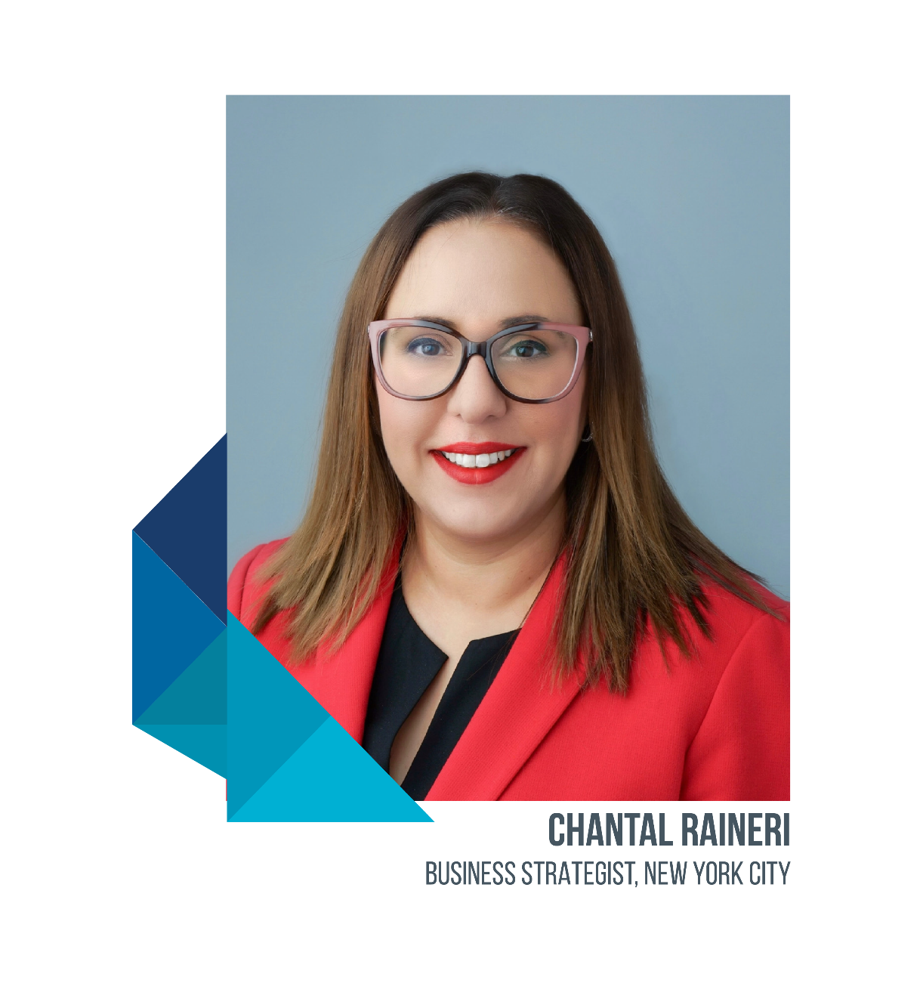

MMA Introductions
Team Presenting
Consultant leading account team service, compliance, communication, renewal, and daily service activities.
Consultant responsible for strategy, carrier negotiations, financial assurance overall relationship.
Consultant leading account team service, compliance, communication, renewal, and daily service activities.

Slide 3

We’re the actual creative insurance broker that you’re looking for.

Slide 4

What We Heard
Objectives of VaynerMedia
With layoffs/furloughs, there is an increased importance in taking care of and retaining key employees.
Diversity, Equity & Inclusion is front of mind, with hiring of Chief Diversity Officer.
Emphasis in evaluating DE&I as it pertains to benefits.
With move to HRIS platforms like Hibob, optimizing technology and decreasing HR administrative burden is vital.
Streamlining and automating compliance can further assist with allowing HR to focus on strategic vision versus automated tasks.
While plan costs are not significant compared to prior years (due to COVID-19), planning for the future and ensuring that health plan performance is strong (no waste/inefficiency).
Marsh & McLennan Insurance Agency LLC

Slide 5

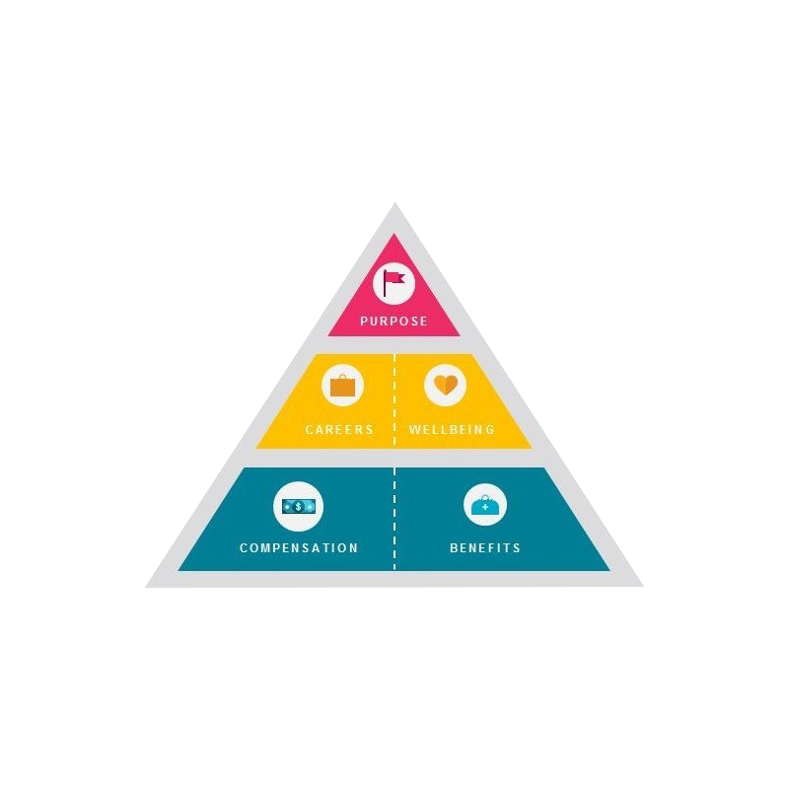
Benefits are not the only answer to keeping your best employees, but are a vehicle to further strengthen the culture, community and shared values of the company.
Emotional
Experiential
Contractual

Slide 6





Benefits as a Retention Strategy
Custom benchmarking and studies.
Emerging trends and data.
Field research and collaboration.
Robust DE&I strategy.

Slide 7
Employer Coverage For Inclusive Health Benefits Varies Widely
Transgender Benefits in the US
Modern Family Planning Benefits in the US
67%
Of Companies Offer Benefits That Assist LGBTQ+ Couples With Family Planning And Care, of That:
Company Benefits Provide Coverage for Gender Affirmation Treatment for Individuals Suffering from Gender Dysphoria
52%
10%
38%
Yes
No, but planning to
in 12 months
No
11%
Surrogacy
Infertility Treatment (Reproductive Technology)
Adoption
Parental leave on an equal basis as opposite sex couples
REASONS WHY IT’S NOT OFFERED
5%
  Legal restrictions
58%
6%
Cultural or social preconceptions
9%
Company values/morals/beliefs
68%
16%
Lack of capable vendors/carriers to provide this benefit
20%
No budget
90%
25%
Do not know how to implement such a benefit
Source: LGBTQ+ benefits around the world 2017 – US Country Snapshot

Slide 8
DE&I Gap Analysis
1
2
3
Current State Gap Analysis
Minimum Standard Benefit Design
Implementation
Data Inventory
Workshop to design Transgender and Modern Family Planning minimum standard benefit design based on:
  Clinical best practices
  Diversity and inclusion best practices
  Risk tolerance
  Legal and compliance
  Cost estimation and budget
  Medical carrier and point solution vendor integration
Review point solution vendor landscape for Transgender and Modern Family Planning to support the employee healthcare journey
Benefit Enhancements
Diversity policies and philosophy
Medical summary plan designs and coverage details from each medical carrier
LGBTQ+ and Family Planning survey
Transgender and Modern Family Planning claims utilization data
Obtain pricing for benefit enhancements and point solutions
Negotiate final design with medical carriers
Implement new point solution vendors for benefit integration
Benefit Administration
Gap Analysis
Medical carrier SPD updates for benefit enhancements
Confirm claim adjudication process with medical carrier and point solution vendors, if applicable
Review employee communication language introducing benefit enhancements
Policy review
Medical coverage offering analysis in comparison to clinical best practice
Survey benchmarking
~4 weeks
~6 weeks
~12 weeks

Slide 9




The ThinkHR Workplace
THINKHR LIVE
Real-time Advice and Answers from Live HR Experts
99% same-day answer rate
Available 11 hours each day
SPHR/PHR- and SHRM-certified advisors
Online submission, documentation and follow-up
CLOUD BASED PLATFORM
THINKHR COMPLY
THINKHR CRUNCH
THINKHR LEARN
Award-winning
Resource Center
Proactive News
and Expert Analysis
Training Courses for Compliance and Employee Development
Q&A Database
Forms and Documents
Tools and Checklists
Employment Law and Legislative Updates
ACA and Compliance Changes
200+ Online Courses
Created by Experts
9
Notes:
Patti
Notes/How to Use:
Hit these at a VERY high level. For example, say – “We have four solutions. We’ll go into more detail on them later, but for now, know that they are…
ThinkHR Live – Hotline to HR Experts
Comply – online resource and knowledge base
Learn – online training courses
Insight – news and communications from ThinkHR to you and your groups
National network of compliance attorneys and subject matter experts
11 compliance attorneys and local dedicated compliance strategist
Live HR support from certified HR professionals 11 hours per day via ThinkHR
Articles, seminars, webinars, reference guides and consultation with attorneys included as part of our client service model
Form 5500 / SAR Filings
WRAP Document support; SPD and Plan Document Review

Slide 10
MMA Value Added Services
iNGAGED Communication Platform | MMA Individual Exchange Access
HR360 (ThinkHR $100 buy-up) | 2nd Level MMA Claims Concierge for Complex Claims
Brainshark Educational Videos | On-staff ERISA Attorneys
Industry Benchmarking | 5500 Preparation
Wellness Program Development / Communications / Support | Wrap Documents
Health Advocate | Compliance Review
Deployment of Benefit Hub – Employee Discount Marketplace | Open Enrollment Benefit Guide Books
Notes:
Chantal
6th Pillar – Value Adds.
This slide summarizes many of the value adds associated with working with us. . . . Most of which we have already discussed – review . . .
- Included:
- Optional*

Slide 11
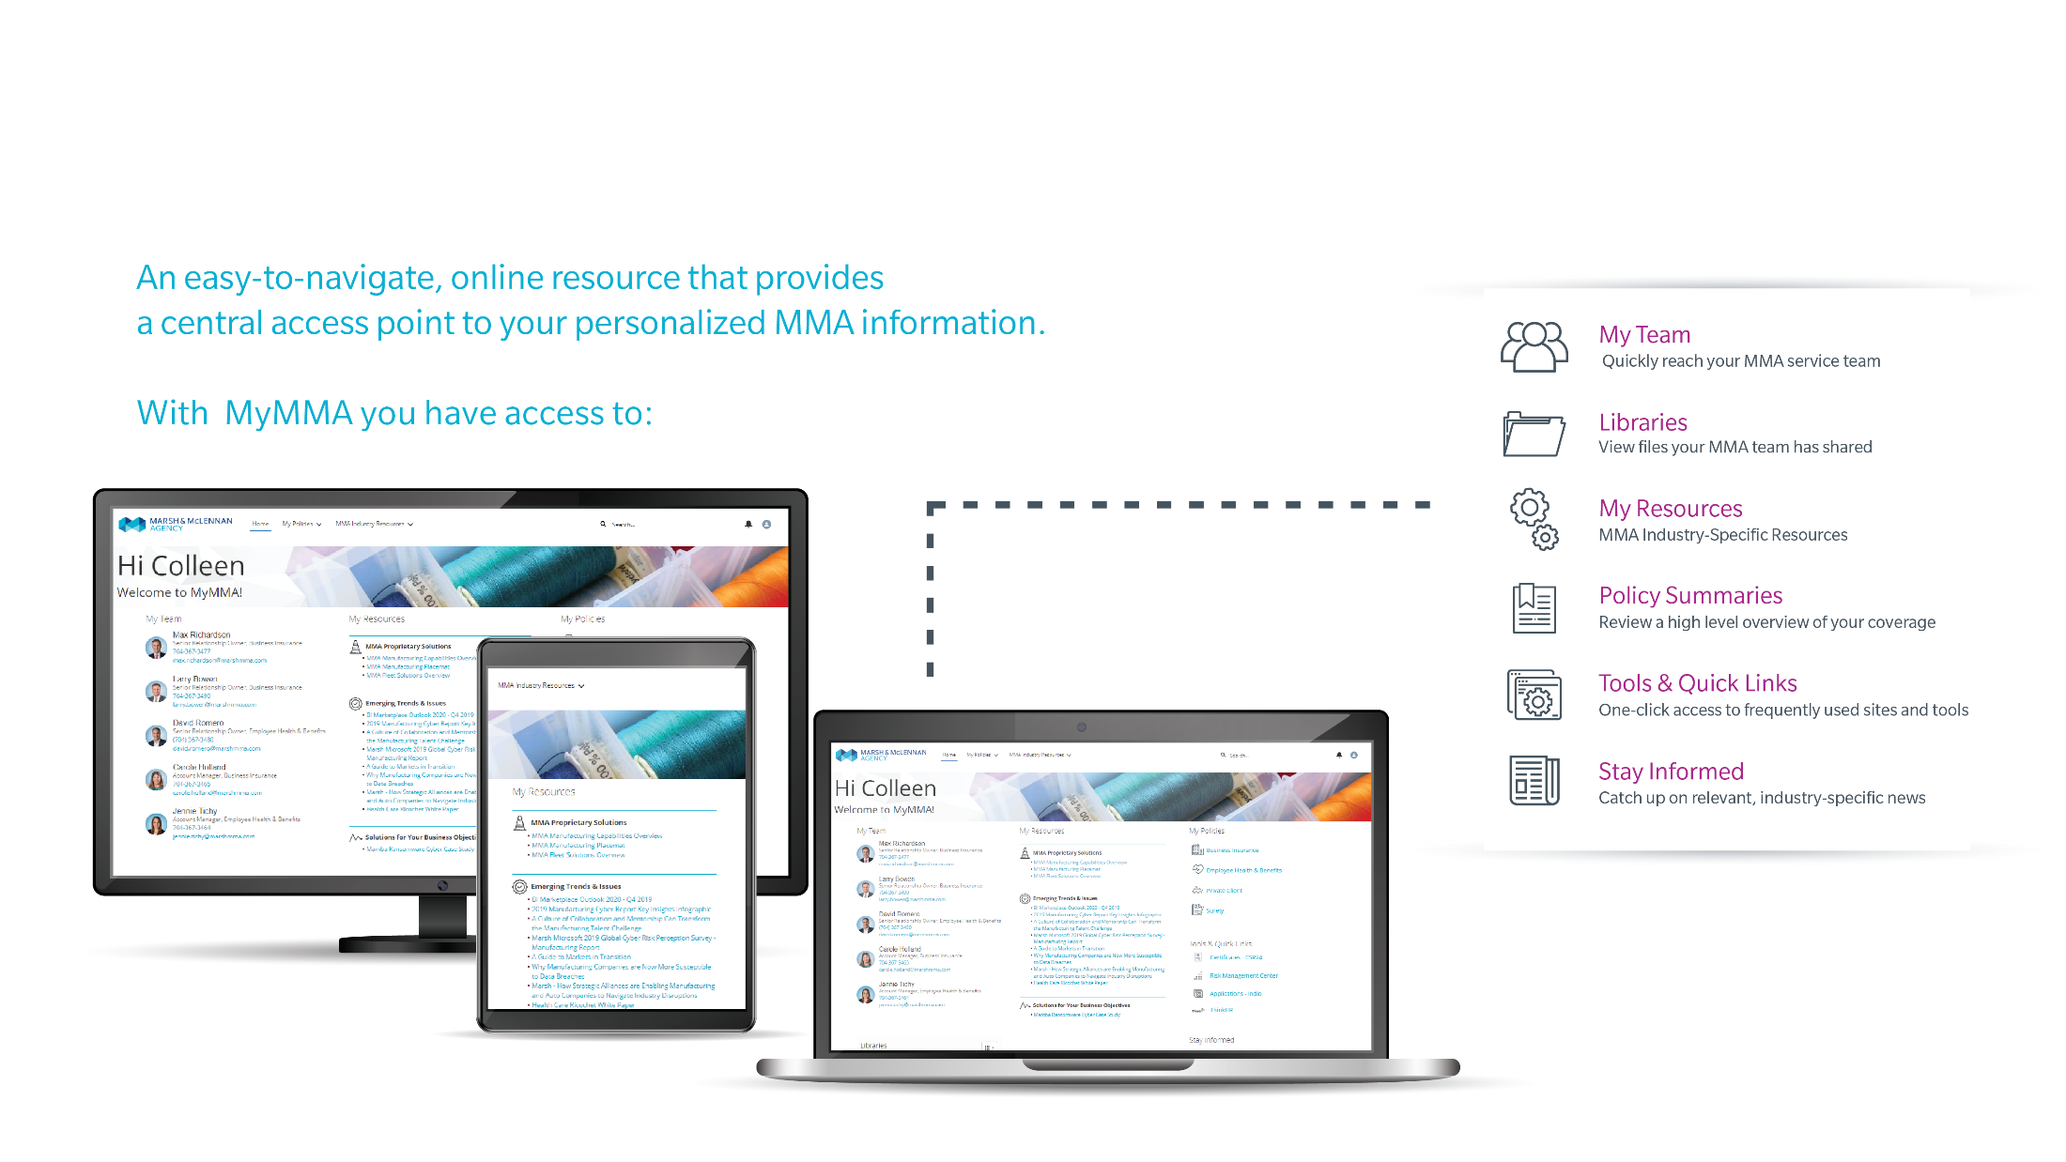

Technology: Optimization and Integration
Quality over quantity
Decision support tools that integrate with Hibob
Mobile app with SSO options
Custom benefits videos that can integrate with any platform/document
24/7 access to cloud based client portal

Slide 12
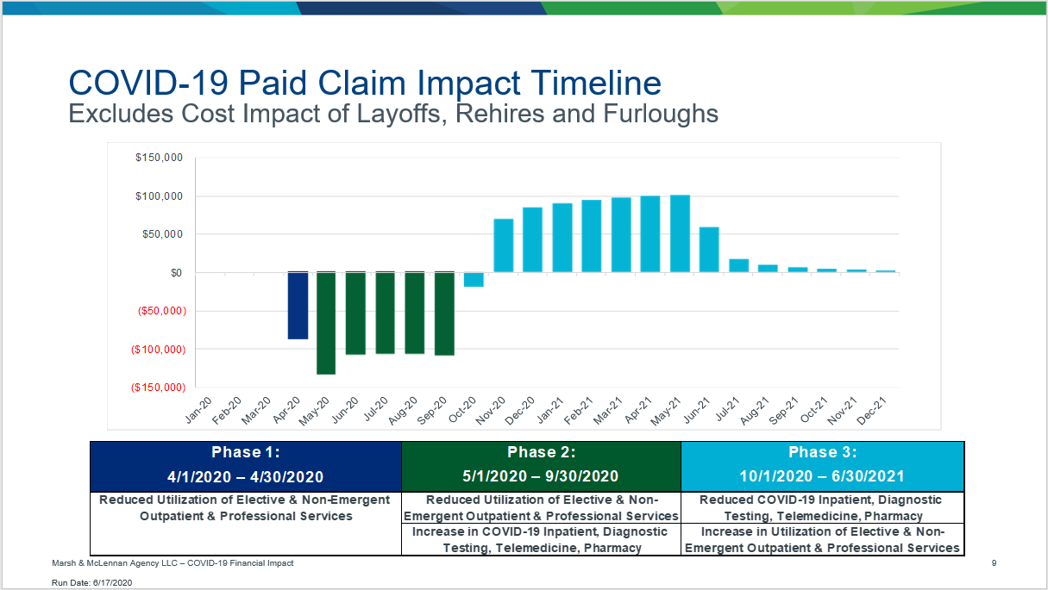
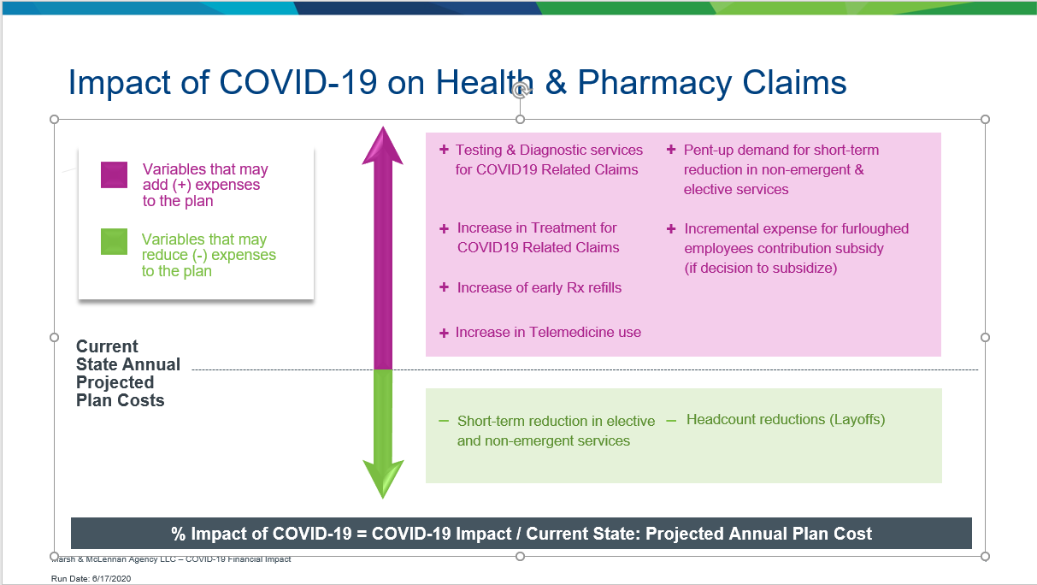
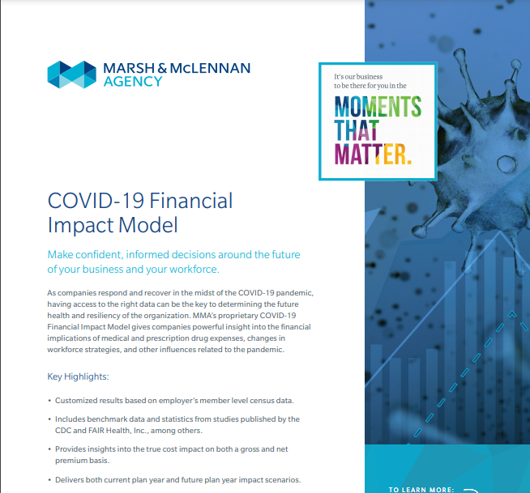
COVID-19 Financial
Impact Analysis
Estimate the financial impact of COVID-19.
Collaborate with your medical carrier/TPA to
understand and evaluate any cost projections.
Adjust your medical plan budget (2021) and
IBNR if needed.
Monitor emerging information & experience.

Slide 13

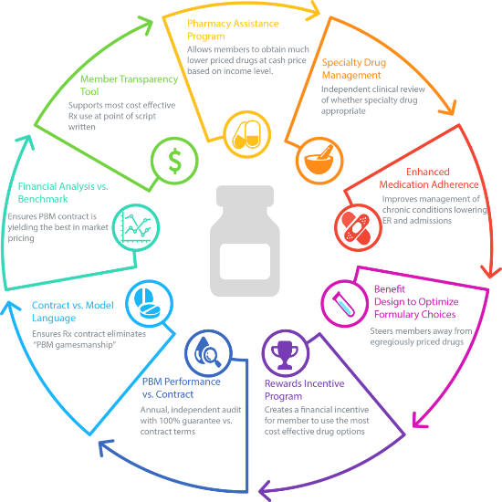
The Client: 800 Employees | $2.6 million in Rx spend
MMA Rx Solutions
CASE STUDY
The Objective: Pharmacy savings through expert negotiations
The Challenge
The client wished to remain on current PBM, however felt it was necessary to review the pharmacy contract to ensure market competitiveness.
The Solution
The Rx Solutions team performed a market RFP and program evaluation. Evaluation highlighted opportunity to:
  Improve price paid per drug
  Increase rebate cost sharing
  Review 3-year contract to 1-year
The Result
Client saved $484K on their pharmacy program with no plan changes.
This was done by:
  Reclassifying drugs to a higher cost category
  PBM reduced medical administration fee
  Shift to a 1-year contract with annual reconciliation

Slide 14

MMA Rx Solutions
75 Years
15% Average
Rx Savings
$131 Million
pharmacy experience
with 70% of clients not changing their PBM
total savings for MMA Clients
Notes:
MMA Rx Solutions consistently achieves savings and maintains market competitive RX contract for our clients. Our advanced pharmacy expertise allows our team to negotiate from a position of strength with carriers and PBMs. We consistently advance our strategies to stay ahead of the market, so that our clients are able to bend the cost curve in their favor.
With over 15% average Rx savings, and over 70% of our clients remaining with their inforce PBM, MMA Rx Solutions is changing how the PBM industry manages their client relationship. The MMA Rx Solutions team has yielded over $131 million in savings for our clients, and we believe this is only the beginning of how we can catapult the client to obtain Rx risk control.

Slide 15




Additional Financial Strategies
A resource dedicated to helping our clients understand and limit their risk with preferred contract terms and the unmatched leverage of Marsh & McLennan.
Planning & Analytics for Total Health (PATH) is the clinical engine developed to drive population health and risk management strategies for our clients.
Network valuation model offering an apples-to-apples comparison of health benefit costs by network, enabling clients to make better network selection decisions.
Strategic planning and forecast model
Advanced analytics and pharmacy intelligence to help our clients evaluate, optimize, and protect their Pharmacy Benefit Manager (PBM) contracts.
Demographic Analysis
Notes:
Chantal
MMA’s digital administration solutions span all group sizes from larger employers, using MMA MarketLink, to those with under 100 employees, using MMA HRLink to administer employee benefits at open enrollment, and throughout the year.
Additionally, progressive employee benefits strategies and offerings are supported through programs like NaviLink, a streamlined enrollment and education tool that our clients use to implement an effective voluntary benefits campaign.
Our mobile platforms, iBenefits, and iNGAGED will enhance our clients’ communication campaigns, and ultimately, actively engage employees in using their benefits effectively and managing their health.
Strategic forecast model
Demographic analysis

Slide 16
Strategic Path Forward
Timeframe | Activity
January | MMA to meet with VaynerMedia team Discuss Scope of Services Agreement
February | Onboarding Renewal Planning Benchmarking Begin Marketing and Financial Review Selection of additional resources & technology implementation timeline Wellness Design Discussion
February | Review Marketing Results
February | Finalize Recommendations / Implement 2021 Insurance Plans Set up Open Enrollment Schedule Prepare Communication Materials
March | Open Enrollment
April / May | Post Open Enrollment Review & Audit
April / May | Review Billing Statements
June | Post Renewal Engagement Meeting
Notes:
Chris
We have developed a preliminary outline of the next steps for the transition. Which would include:
- collecting current plan information and benchmarking the plans
- Setting up the MMA value adds (such as the employee call center, Benefits Hub discount site, HR support . . .
- marketing of the plan
- negotiating and finalizing the renewal plan designs and rates
- developing the employee contributions
- preparing for open enrollment – including communications and an analysis of enrollment technology solutions
- Conducting open enrollment
- Finalizing enrollments and facilitating a post enrollment discussion
Do you have any additional questions for us?

